Slide 1
Intro to Multiprocessing
CS 0449
Jarrett Billingsley

Slide 2
Class announcements
have you done lab 7 yeeeeeeeet???

Slide 3
Multiprocessing

Slide 4
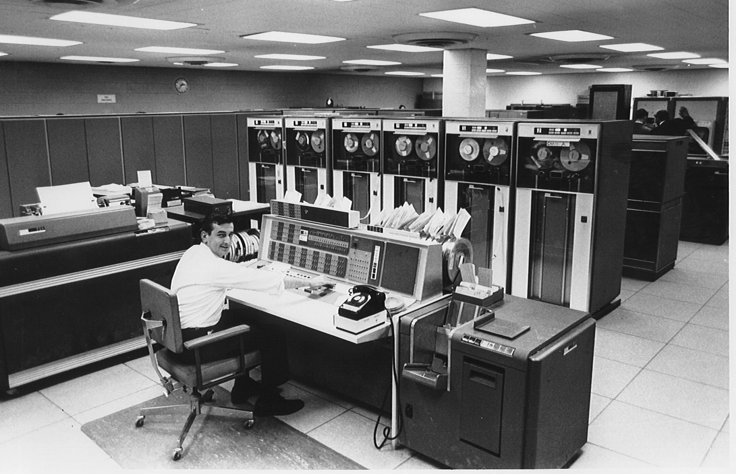
Where'd it come from?
computers used to be huge
like.. physically
and therefore expensive
like.. millions of dollars
so many people had to be able to share one computer at once
like.. modern web servers
multiprocessing is: running multiple programs (or tasks) at the same time on one computer
Notes:
- this is the thing you'd connect to with a teletype.
[image: a 1960s (?) era computer room, filled with refrigerator-sized computers and magnetic tape drives, with a man at a desk in the middle]

Slide 5
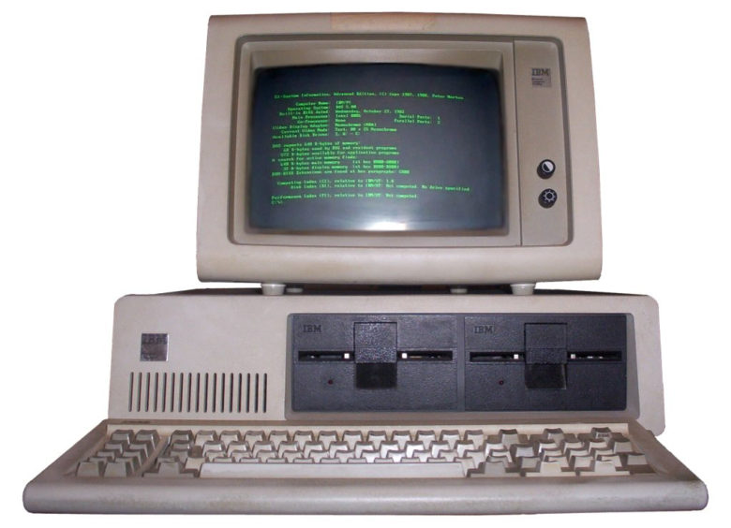
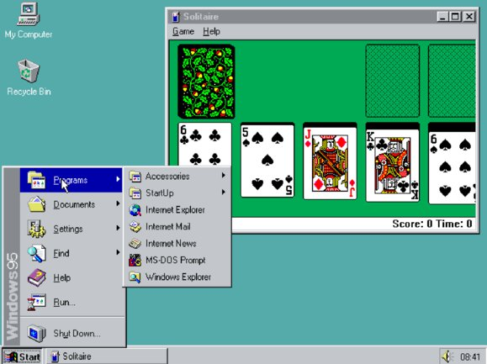
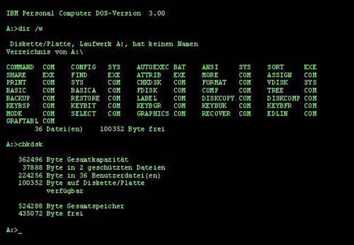
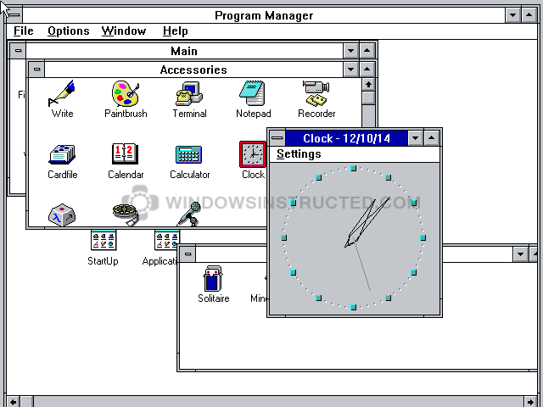

And then they got small
personal computers (PCs) weren't A Thing until the 1970s, and weren't really popular until well into the 1980s
limited and basic at first, but…
Notes:
- aaaaand things haven't really progressed much since windows xp tbh
[images: the rapid progression of the complexity of personal computer operating systems from the late 70s to the mid 90s]

Slide 6


For some context
consider a large application with many parts… like a web browser.
internet
slow I/O
responsive GUI
▸
slow I/O
/\/\/\/\/\/\/\/\/\/\/\/\/\/\/\/\/\/\/\/\/\/\/\/\/\/\/\/\/\/\/\/\/\/\/\/\/\/\/\/\/\/\/\/\/\/\/\/\/\/\/\/\/\/\/\/\/\/\/\/\/\/\/\/\/\/\/\/\/\/\/\/\/\/\/\/\/\/\/\/\/\/\/\/\/\/\/\/\/\/\/\/\/\/\/\/\/\/\/\/\/\/\/\/\/\/\/\/\/\/\/\/\/\/\/\/\/\/\/\/\/\/\/\/\/\/\/\/\/\/\/\/\/\/\/\/\/\/\/\/\/\/\/\/\/\/\/\/\/\/\/\/\/\/\/\/\/\/\/\/\/\/\/\/\/\/\/\/\/\/\/\/\/\/\/\/\/\/\/\/\/\/\/\/\/\/\/\
real-time video
interpreting code that strangers wrote in a garbage-collected language
lots of things to balance here: processing speed, latency, security, user experience…
parsing MBs of text
do you think writing this as a single program would be easy?
Notes:
- I mean, you could, but it'd be a pain, and you'd end up reimplementing a bunch of the stuff we'll be talking about.
[diagram: a web browser has a number of parts: a code parser and interpreter; a GUI that has to be responsive; real-time audio and video decoding; parsing megabytes of HTML and CSS code… and it has to communicate over relative slow I/O channels]

Slide 7
"More than 1 program" can be inside 1 "program"
when we say "program" we need to stop thinking "executable file"
a program is a sequence of operations…
and you can have several of those happening at the same time…
working together to solve one problem.
think of it like a team, or company, or society:
you can have multiple people, each with their own responsibilities
and together, they can accomplish a larger goal

Slide 8
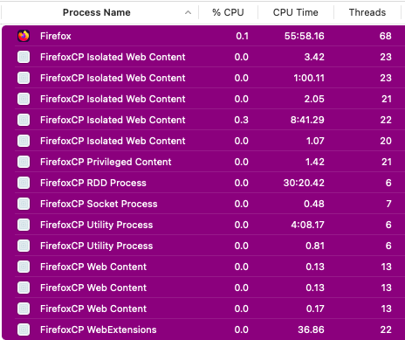
Two dozen processes in a trenchcoat
your web browser might look and act like a single “program,” but it’s likely implemented as multiple processes, which has benefits!
each tab can be put in its own process, which means each tab has no access to the data in other tabs
if one process crashes, it doesn’t take down the whole browser*
multiple processes can run simultaneously – music on one tab, playing a game on another
of course this implies that the processes must communicate with one another somehow… inter-process communication… IPC…
Notes:
- *unless it’s the main “orchestrator” process that directs all the other process but that one is deliberately written to do as little as possible so it’s very unlikely to crash

Slide 9
Scheduling

Slide 10
All my children
at any given time, there are dozens or hundreds of processes running
Process 1
my turn! my turn!!!
I'm the ONLY process! that means I'm the BEST!
Process 173
Kernel
Memory
Memory
Code
Code
AAAAAAAAAAAAAAAAAAAAAAAAAAAAAA
Process 9
Process 92
Memory
Memory
I want all the CPU!!
no I want all the CPU!!
Code
Code
Notes:
[diagram: the kernel is like a frazzled parent being mobbed by greedy children]

Slide 11


Who's who
some processes use LOTS OF CPU
others just sit around most of the time, waiting for input or output (I/O)
enter your choice: rock
the computer chose rock. tie!
enter your choice: paper
the computer chose rock. you win!
you: 1, computer: 0
enter your choice: _
g++ somefile.cpp
Loading…
we call these CPU-bound
we call these IO-bound
Notes:
- processes can be mixes of these or change from one to the other during their lifetime, ofc

Slide 12


I'm turning this car around
I wanna watch the weather…
lemme just beat this boss okay???
if we give the CPU-bound processes priority…
…then the IO-bound ones never get a turn.
mommy has a lot of work to do, Billy
if we give the IO-bound processes priority…
johny johny yes papa
…then the CPU-bound ones can't get work done.

Slide 13

Scheduling
scheduling is how we make the processes take turns on the CPU
all the many ways of doing scheduling do the same basic thing:
P1
P2
P5
P9
P1
P7
0
1
2
3
4
5
6
7
8
9
10
11
12
13
14
15
16
17
time
we're slicing up time and giving each slice to a different process.
scheduling answers the question: "which process takes control of the CPU next?"
Notes:
- it's resource allocation, but the resource is time.
- this is an entire unit in 1550; have fun with it (if you take it, since it’s an elective now lol)
[diagram: a timeline divided into units. each process gets to use the CPU for some slice of time. P1 runs for 3 units, then P2 for 5 units, then P5 for 2 units…]

Slide 14
What about multiple cores?
a core is a CPU. a "multi-core CPU" is 1 piece of silicon with >1 CPU.
P1
P5
P1
core 1
P2
P9
P7
core 2
0
1
2
3
4
5
6
7
8
9
10
11
12
13
14
15
16
17
time
it's the same idea, but now you can do more work in less time.
Notes:
- multi-core scheduling introduces new complexities – core affinity (forcing a process to only run on one specific core), caching issues with shared memory, fun things like kernel data exfiltration by exploiting the caching system lmao
[diagram: the same timeline and processes, but now two processes can be running at the same time, so it looks like two timelines stacked up on top of each other.]

Slide 15
Kinds of scheduling

Slide 16
Preemptive scheduling
in this method, the OS can interrupt a process that's taking too long
k, I'm done
doo dee doo
but.. but I wasn't…
haha suckerrrr
P1
P2
P5
0
1
2
3
4
5
6
7
8
9
10
11
12
13
14
15
16
17
P2, your turn
ok P2 that's enough… P5, go!
(to be clear, P2 isn’t “dead,” it was just forced to give up the CPU.)
Kernel
Notes:
[diagram: process 1 gives up the CPU gracefully. then P2 runs for a long time, and the kernel steps in and says "no more!" and gives the CPU to P5.]

Slide 17

Interrupted by an interrupt (animated)
to make this work, we need special hardware in the CPU
wheee!!!
hey timer, wake me up in 100ms
CPU
P2
Kernel
P2, gtfo
RING RING!!!!
the timer causes a hardware interrupt…
…and only the kernel is allowed to respond to interrupts.
the quantum is how long a process is allowed to run before it's preempted (i.e. how long the timer is set for).
Notes:
- the quantum is on the order of tens to hundreds of milliseconds on most systems, from what I can tell.
[diagram: remember the interrupts from the end of last lecture? the timer causes an interrupt which only the kernel can respond to, and therefore it can always regain control of the CPU.]

Slide 18
Preemption doesn’t mean killing the process!
preemption is a strategy used by the kernel to switch processes.
the preempted process isn’t killed, it’s just paused.
…it’s just that, the kernel decides when the process pauses, and the process has no control over that.
a process could be paused anytime, anywhere, like:
after running for 5 seconds
after running for 5 microseconds
in the middle of a function
in the middle of an increment
oh we’ll see (:

Slide 19

Collaborative scheduling
in this method, each process must say "I'm done with my turn" before another process gets to run
this is simple to implement and doesn't require any fancy OS or hardware features!
…but we all know the problem with taking turns
Notes:
[diagram: that kid is still hogging the video game]

Slide 20
What a hog
the problem with collaborative scheduling is…
if a process never gives up the CPU, nothing else can run.
not even the kernel.
so it's unfortunately really, really easy to make a collaboratively scheduled OS freeze…
while(true) {}
aaaand now you have to restart the computer.
Notes:
- typically these systems will have a way to terminate the rogue process, but it requires user interaction
- this is where ctrl+alt+del came from: on MS-DOS, it was set up to send a hardware interrupt to the CPU
- by using it you could force the process to give up the CPU and go back to the kernel
- but it's a bit of a hack and can't be automated.

Slide 21
Blocking

Slide 22
This is not a trick question
when you call a function, what happens?
void fork() { knife();
spoon++;
}
void knife() {
spork++;
spatula--;
}
when does knife() return to fork()?
what is fork() doing while knife() is running?
what if we generalized this idea?
Notes:
- knife() returns to fork() when it finishes executing (i.e. it returns).
- while knife() is running, fork() is waiting on it… it cannot continue execution until knife() finishes.
- WHAT IF!!

Slide 23
More than just a function call
what if you do a system call instead?
void fork() { fgets(...);
spoon++;
}
here's the important thing: at this point, the user process cannot continue until this system call returns.
so we could do… anything.
we say that the process is blocked.

Slide 24

How the OS does blocking system calls
every process is under the illusion that it's the only thing running.
fgets()
fgets() returns!
process 1
that's gonna take a while… process 2, it's your turn!
process 2, hold on. oh, the user pressed enter. process 1, resume!
kernel
process 2
fopen()
from process 1's perspective, all that happened was a function call.
this is the power of the abstraction the OS gives us.
Notes:
- the grey dotted lines are when the process is blocked/sleeping.
[diagram: a timeline. process 1 runs for a while. it calls fgets(), which performs a syscall and drops into the kernel. the kernel schedules process 2. then process 2 does a syscall, back into the kernel. now the kernel notices process 1's syscall can complete, so it returns to process 1.]

Slide 25
Threads

Slide 26

But context switches are haaaardddd
processes are big things with many parts
open files
Stack
Heap
Globals
Code
internal kernel data structures
34
register values
process 14 has been running for 8 years and shows no signs
35
of stopping. what the hell is it doing
Reg | Value
rsp | 0x00007FFFFFEFF8A0
rip | 0x0000555508000017
rax | 0x000000000000038B
rbx | 0x000055550080337C
... | ...
memory space
sure would be nice to get some of the benefits of multiprocessing without all the overhead…
Notes:
[diagram: nothing special.]

Slide 27
The sweet, gooey center of a process
we want to run multiple pieces of code at once
do we really need a whole new heap, code, files, etc. for that?
Process
a thread encapsulates only what's needed to run some code.
Heap
Globals
Thread
Thread
Code
Stack
Stack
PC
PC
Files
Registers
Registers
and we can have several threads for each process.
Notes:
- we do need to allocate a new stack whenever we create a thread, but that's not a big deal.
[diagram: until now, we've thought of a process as having globals, code, heap, stack, files, and registers (including the program counter). but if we extract the stack and registers into a thread, we can have multiple threads of execution – multiple different pieces of code running at the same time – within ONE process. they all share the globals, heap, code, and files.]

Slide 28

Thread hopping
what has this gained us? well...
Process
open files
Stack
Thread 2
Stack
PC
Thread 3
Heap
Globals
Code
Registers
PC
Registers
Stack
Thread 1
PC
switching threads amounts
to changing some registers –
everything else stays the same.
Registers
Notes:
- even switching stacks only requires changing the sp/bp registers.
- but this opens up a whole new pandora's box of coding challenges… synchronization, race conditions, deadlocks and more! yay!

